Slide 1
IT8701 CA1 Presentation
By Timothy Ng Tik Ti AI03

Slide 2
Wanting to find out if more people are getting married or not
ASSUMPTIONS
Assuming correlation is tied directly to people applying family grant scheme or singles grant scheme
Assuming the numbers applying for family grant scheme with parents/non-spouse and numbers applying for singles grant scheme while being married to be negligible
Data from: https://data.gov.sg/dataset/households-that-benefitted-from-cpf-housing-grant

Slide 3
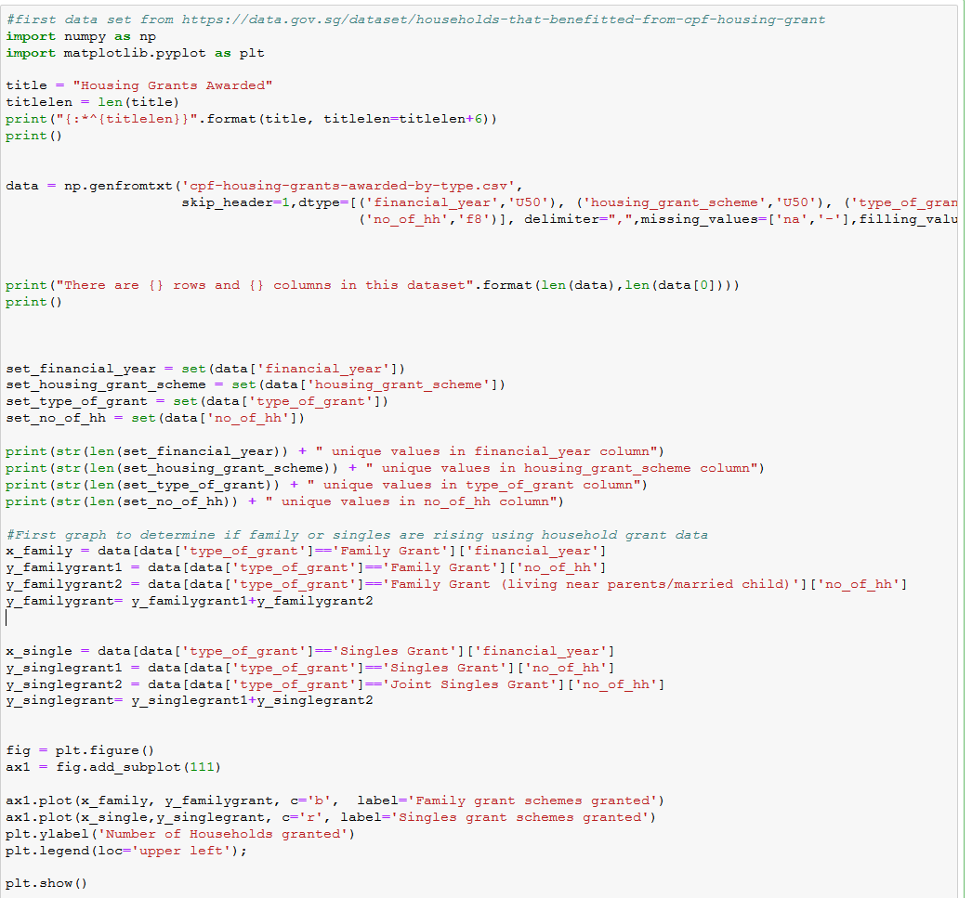
Wanting to find out if more people are getting married or not: Python Code

Slide 4
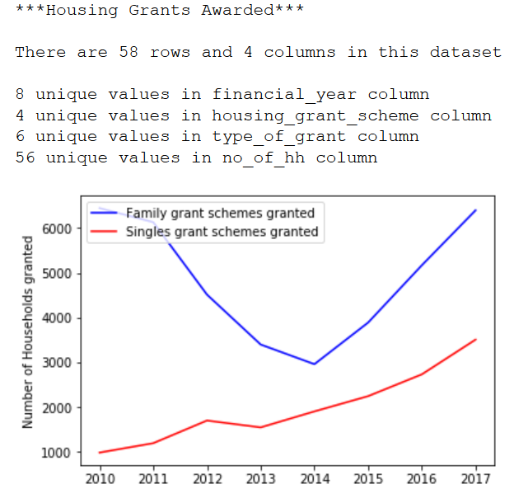
Wanting to find out if more people are getting married or not: Plot and Analysis
The line plot shows that singles grant scheme has been steadily increasing, while family grant scheme was decreasing with increasing singles til 2014, then suddenly increases along with singles grant scheme.
Signals potential policy implemented around 2014, causing an increase in population, such that even with increasing singles, family scheme increased as well too. It’s potentially either the family scheme became more attractive, or that an massive influx of families entered singapore

Slide 5
To find out how rental varies with room type
ASSUMPTIONS
Assuming time period doesn’t affect the result of this as much due to large sample size, and that it’s representative of fluctuation in prices in today context
Assuming location doesn’t affect prices the result of this as much due to large sample size, and that since almost every location has all the room type, that it doesn’t matter too much to our hypothesis that we are trying to draw
Data from: https://data.gov.sg/dataset/median-rent-by-town-and-flat-type?resource_id=6b1ec2ff-7c38-4ce9-9bbb-af865b4d78cb

Slide 6
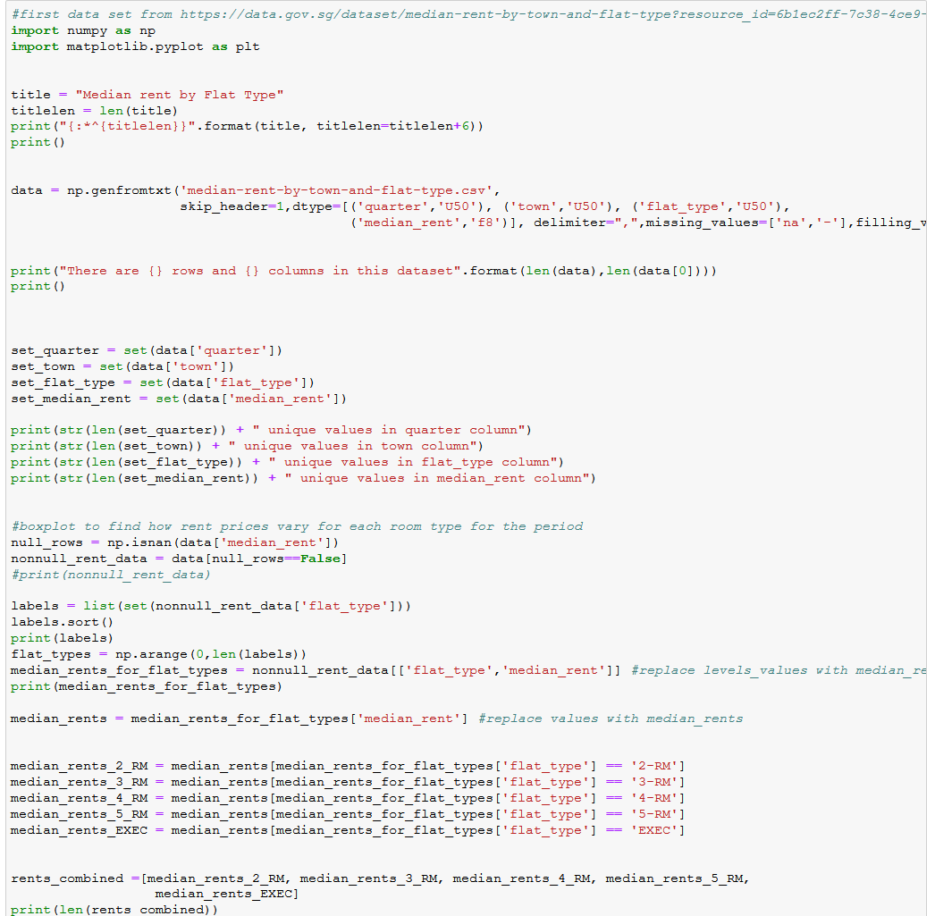
To find out how rental varies with room type: Python Code

Slide 7
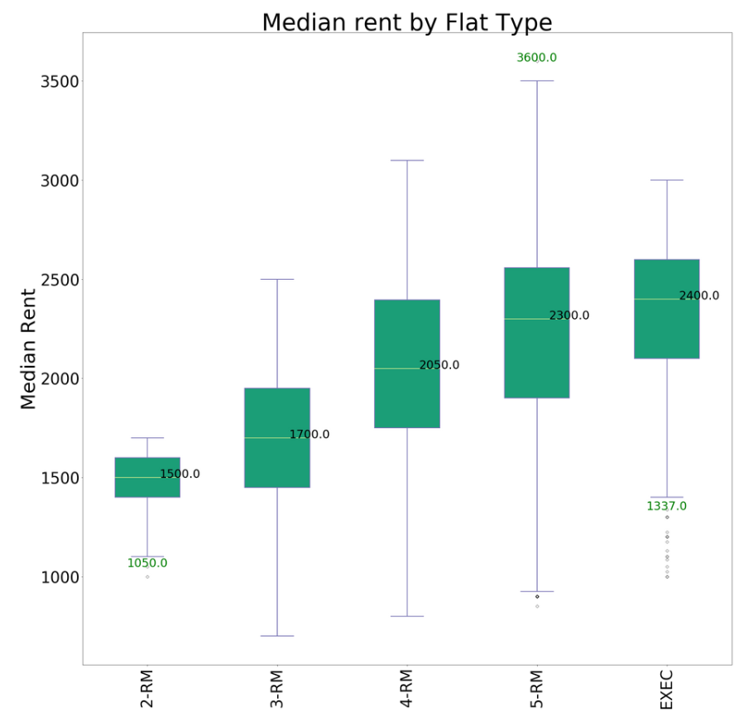
To find out how rental varies with room type: Plot and analysis
As expected, the prices at different points (ie. Q1, median, Q3, min, max) generally increases from 2-rm to exec type. The median rental increases consistently
The rental prices are generally more consistent for 2-rm and exec type, compared to the rest, with smaller spread
This more consistent spread might be due their demand for rental are less compared to the rest, so there’s not much free play on the prices at the moment

Slide 8
Finding out Correlation Between house size and resale price in between 2 estates
ASSUMPTIONS
Used Bedok and Yishun as reference in this exercise
Data from: https://data.gov.sg/dataset/resale-flat-prices

Slide 9
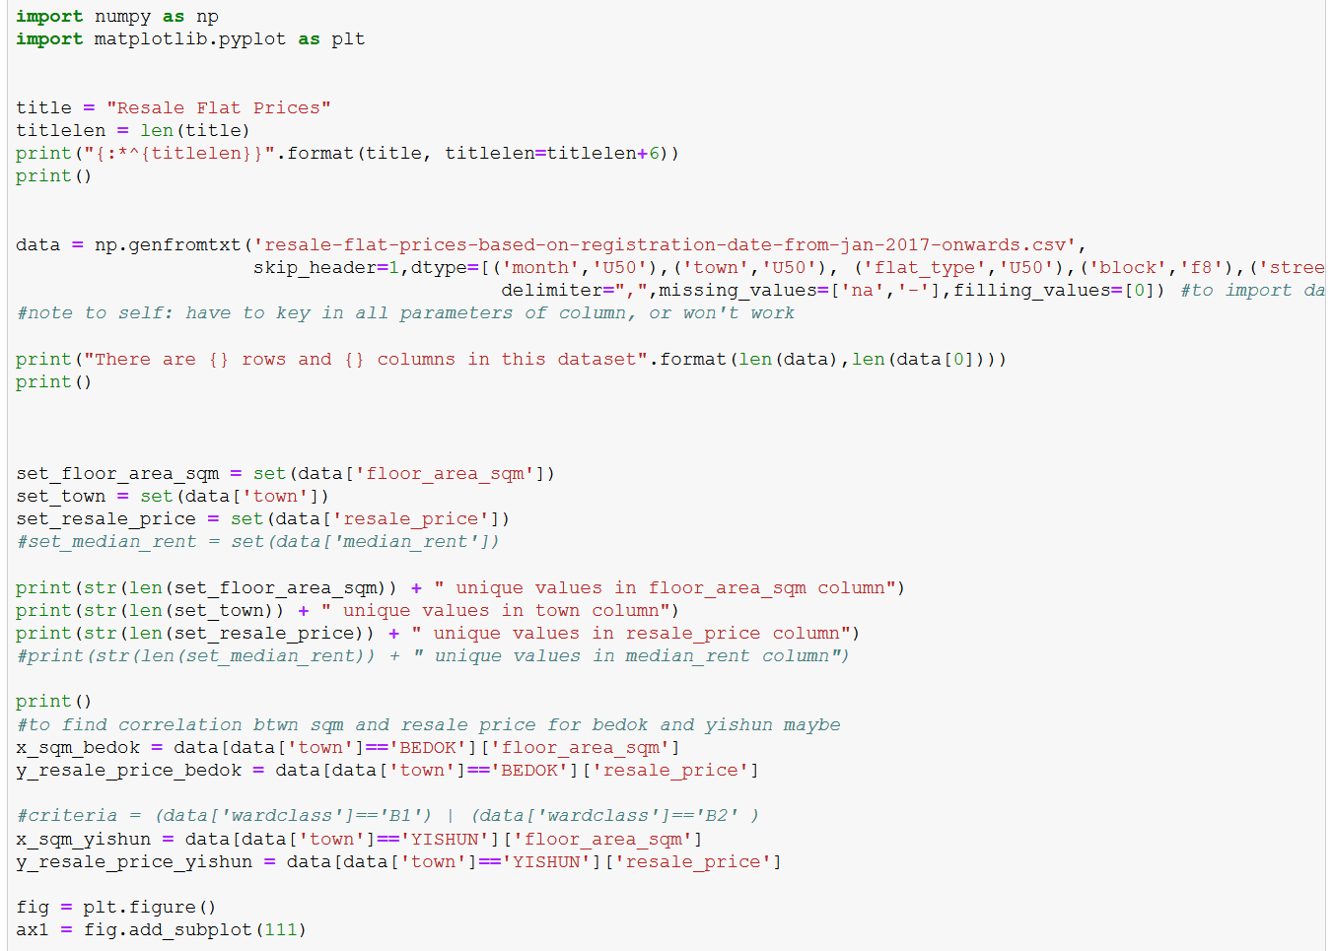
Finding out Correlation Between house size and resale price in between 2 estates: python code

Slide 10
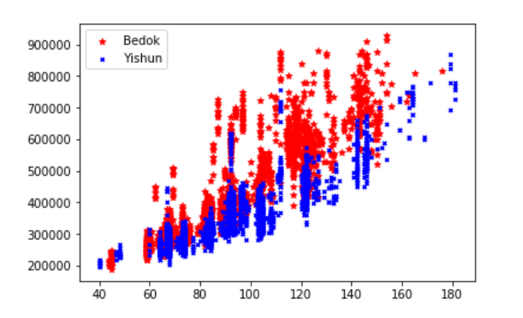
Finding out Correlation Between house size and resale price in between 2 estates: Plot and Analysis
Both towns showed relatively positive correlation, with Bedok being a lot more spread out than Yishun
This means that prices in Yishun fluctuates less across all house sizes and prices in Bedok seems more volatile for a given size
Might be due to many factors (maybe location, proximity to school programs in certain years, population age group, ethnicity)

Slide 11
Finding Average Resale Price across town
ASSUMPTIONS
Assuming time period doesn’t affect the result of this as much due to large sample size, and that it’s representative of fluctuation in prices in today context
Data from: https://data.gov.sg/dataset/resale-flat-prices

Slide 12
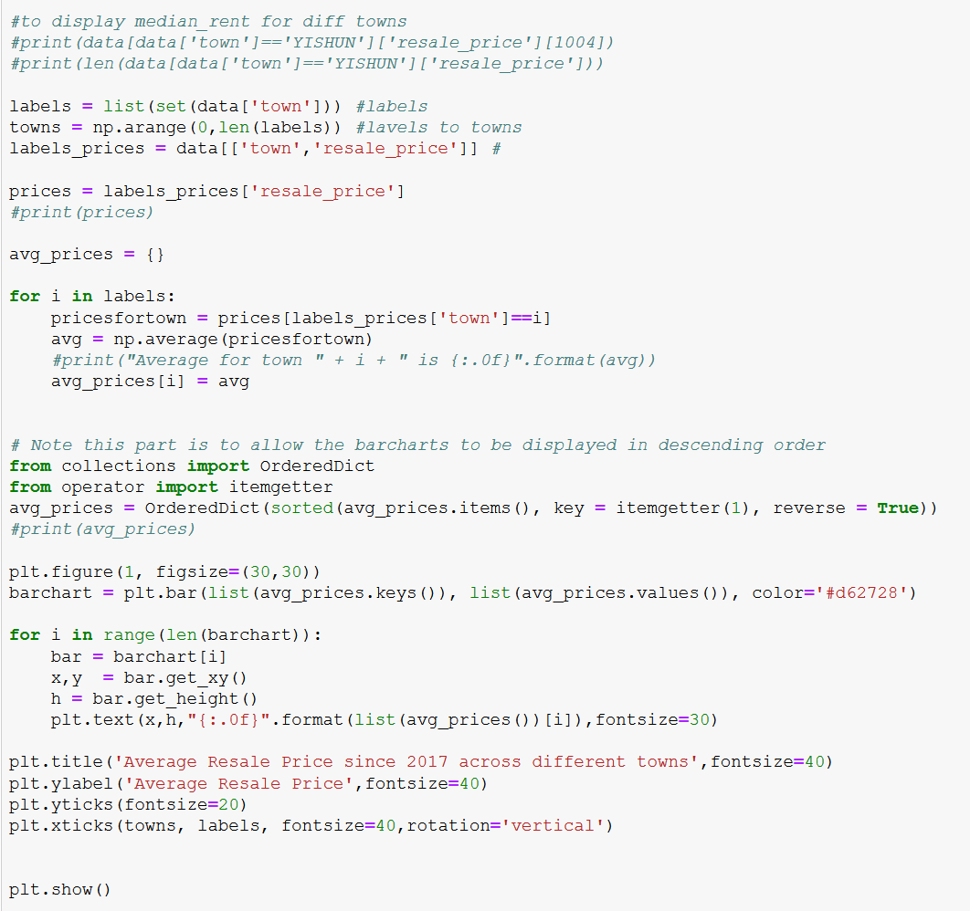
Finding Average Resale Price across town: Python code

Slide 13
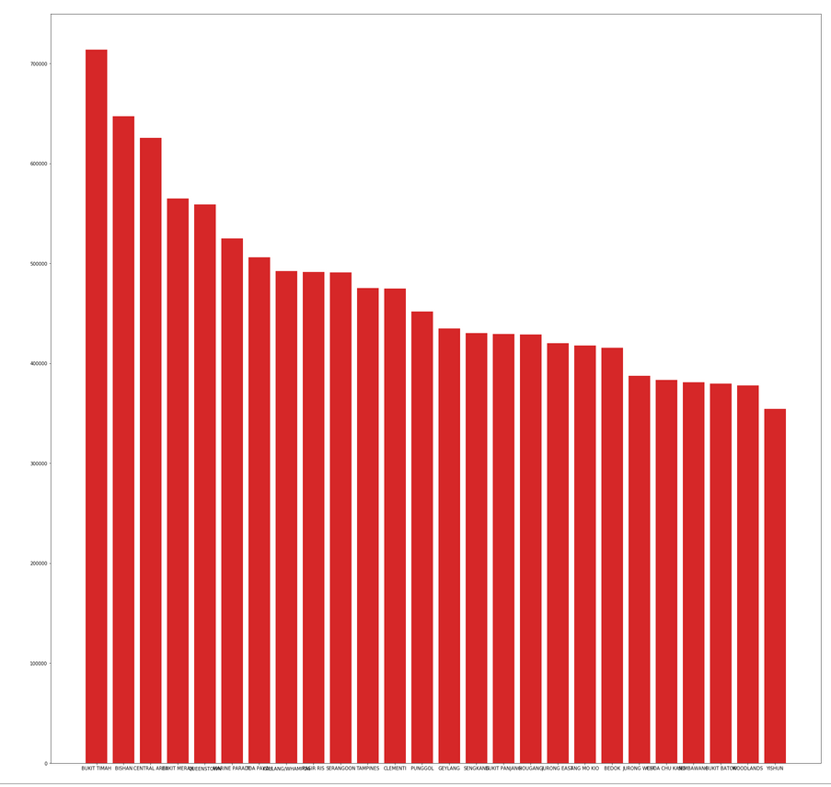
Finding Average Resale Price across town: Plot and Analysis
Average resale prices are highest in Bukit Timah, meanwhile lowest in Yishun
Possibly due to many factors (demographic around location, development around the area, etc)

